Slide 1
Introduction to Object-Oriented Programming in Python
Week 6
Ph.D. Junetae, Kim
Assistant professor

Slide 2
Introduction to object-oriented programming in python
Object-Oriented Programming

Slide 3
Introduction to object-oriented programming in python
What Is object-oriented programming in python?
A programming paradigm that provides a means of structuring programs so that properties and behaviors are bundled into individual objects.
For instance, an object could represent a person with properties like a name, age, and address and behaviors such as walking, talking, breathing, and running.
An approach for modeling concrete, real-world things, like cars, as well as relations between things, like companies and employees, students and teachers, and so on.

Slide 4
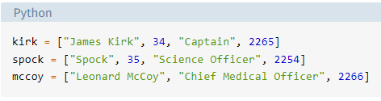
Introduction to object-oriented programming in python
Motivation to use a class
Let’s say you want to track employees in an organization. You need to store some basic information about each employee, such as their name, age, position, and the year they started working.
One way to do this is to represent each employee as a list:

Slide 5
Introduction to object-oriented programming in python
Motivation to use a class
There are a number of issues with this approach.
① It can make larger code files more difficult to manage. If you reference kirk[0] several lines away from where the kirk list is declared, will you remember that the element with index 0 is the employee’s name?

Slide 6
Introduction to object-oriented programming in python
Motivation to use a class
There are a number of issues with this approach.
② It can introduce errors if not every employee has the same number of elements in the list. In the mccoy list above, the age is missing, so mccoy[1] will return "Chief Medical Officer" instead of Dr. McCoy’s age.

Slide 7
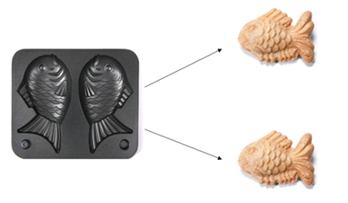
Introduction to object-oriented programming in python
Classes vs Instances
A class is a blueprint for how something should be defined. It doesn’t actually contain any data.
While the class is the blueprint, an instance is an object that is built from a class and contains real data.
A class is like a form or questionnaire. An instance is like a form that has been filled out with information.
Class
Instance, object, entity

Slide 8
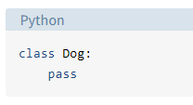
Introduction to object-oriented programming in python
How to define a class
All class definitions start with the class keyword, which is followed by the name of the class and a colon.
The body of the Dog class consists of a single statement: the pass keyword. pass is often used for indicating where code will eventually go. It allows you to run this code without Python throwing an error.

Slide 9
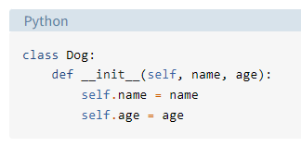
Introduction to object-oriented programming in python
How to define a class
The properties that all Dog objects must have are defined in a method called .__init__()
Every time a new Dog object is created, .__init__() sets the initial state of the object by assigning the values of the object’s properties. That is, .__init__() initializes each new instance of the class.

Slide 10
Introduction to object-oriented programming in python
How to define a class
The properties that all Dog objects must have are defined in a method called .__init__()
You can give .__init__() any number of parameters, but the first parameter will always be a variable called self. When a new class instance is created, the instance is automatically passed to the self parameter in .__init__() so that new attributes can be defined on the object.

Slide 11
Introduction to object-oriented programming in python
How to define a class
In the body of .__init__(), there are two statements using the self variable:
self.name = name creates an attribute called name and assigns to it the value of the name parameter.
self.age = age creates an attribute called age and assigns to it the value of the age parameter.

Slide 12
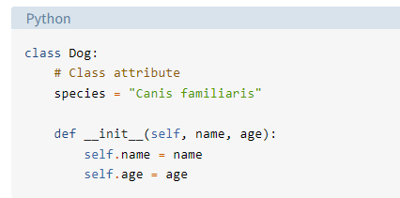
Introduction to object-oriented programming in python
Instance attributes vs class attributes
An instance attribute’s value is specific to a particular instance of the class. All Dog objects have a name and an age, but the values for the name and age attributes will vary depending on the Dog instance.
Class attributes are attributes that have the same value for all class instances.

Slide 13
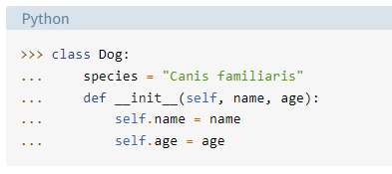
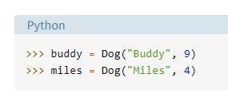
Introduction to object-oriented programming in python
Class and Instance Attributes
Now create a new Dog class with a class attribute called .species and two instance attributes called .name and .age:.

Slide 14
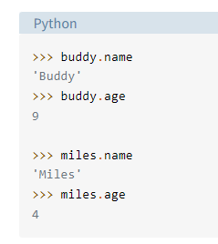
Introduction to object-oriented programming in python
Class and Instance Attributes
After you create the Dog instances, you can access their instance attributes using dot notation:

Slide 15
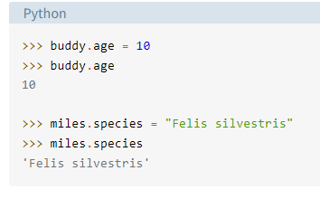
Introduction to object-oriented programming in python
Class and Instance Attributes
Although the attributes are guaranteed to exist, their values can be changed dynamically:

Slide 16
Practice
Practice for class
https://colab.research.google.com/github/JunetaeKim/DeepLearningClass/blob/main/Week6/Week6_Class.ipynb

Slide 17
Student exercise
Exercise 1
Background
Alice is a librarian and she wants to create a simple library management system to track the books and their availability. She needs a class to represent the books in the library.
Question
Create a Python class called 'Book' with the following attributes: 'title', 'author', 'publication_year', and 'is_available'. The class should also have methods 'borrow_book' and 'return_book' to change the availability of a book. Provide a solution for creating a new book object and demonstrate the use of the 'borrow_book' and 'return_book' methods.

Slide 18
Student exercise
Exercise 2
Background
John is a teacher and he wants to manage his students' grades. He needs a class to represent each student and their grades.
Question
Create a Python class called 'Student' with the following attributes: 'name', 'age', and 'grades' (a dictionary containing subject names as keys and grades as values). The class should also have methods 'add_grade' and 'average_grade' to add a new grade and to calculate the student's average grade respectively. Provide a solution for creating a new student object and demonstrate the use of the 'add_grade' and 'average_grade' methods.

Slide 19
Student exercise
https://colab.research.google.com/github/JunetaeKim/DeepLearningClass/blob/main/Week6/Week6_Exercise.ipynb

